Slide 1

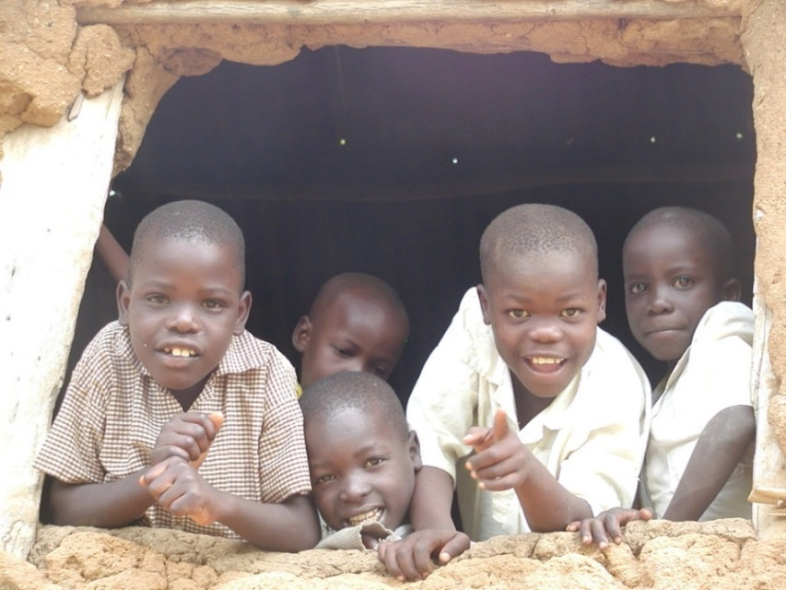
If I Could Start Anew:
Some Reflections of A
Development Economist
Chris Barrett, Cornell University
September 12, 2015
Liberal Arts Colleges Development Economics Conference
Lafayette College

Slide 2
Why did we become development economists?
- Fame?
- Power?
- Money?
- Exotic travel?
Probably not!
Probably more:
- intellectual stimulation (i.e., tackle hard problems)
- the opportunity to have an impact (i.e., tackle important problems)
Aim for Impact

Slide 3
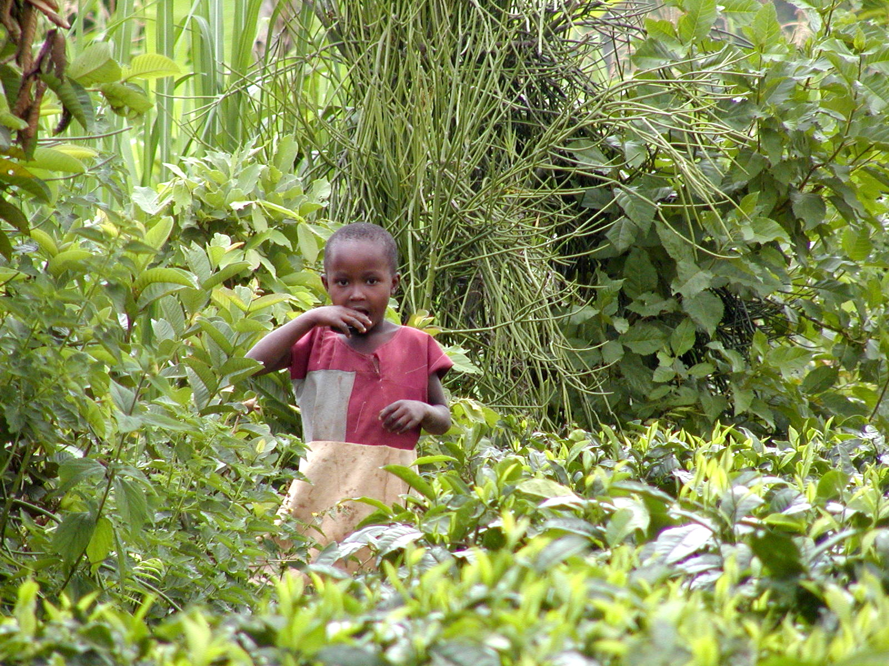
“Most of the people in the world are poor, so if we knew the economics of being poor we would know much of the economics that really matters.”
- Theodore W. Schultz
Opening sentences of 1979 Nobel Prize in Economics lecture

Slide 4
Aim for Impact
So how are we most likely to achieve impact?
Must identify/relax 1st binding constraints:
Knowledge
Time
Access

Slide 5
Knowledge
Development Economics Today
Heavy emphasis on reduced form empirical work with ‘clean’ causal identification .. Premium on survey and experimental design skills, econometrics
Increasing georeferencing of data. GIS skills at a growing premium; spatial econometrics too.
Growing appreciation of the whole human, drawing on psychology, sociology, anthropology to embrace – rather than minimize – the richness of humanness (e.g., Wydick, Haushofer, Mullainathan)
Increased recognition of the poor’s intimate relationship with the natural environment (health, livelihoods, etc.) – learn the relevant (soil, climate, crop, fisheries, etc.) science

Slide 6
Knowledge
Development Economics Tomorrow
More structural work; greater emphasis on computational methods to get at causal mechanisms; more attention to ORV not just endogeneity bias
As markets grow in importance, greater integration with IO and business disciplines (McKenzie, Woodruff, Machiavello, etc.)
More predictive work; machine learning and other high-skill forecasting tools at a premium
Kleinberg et al. (2015 AER P&P)

Slide 7
Time
How to relax time constraints
Develop good time management skills … the rocks, jar and cup of coffee
Students … not just as RAs/TAs, but as the next generation who can take your ideas to the world. And improve on them!
Our greatest impacts typically come not from our contributions of ideas but from our contributions of people … our students, our children.
  So invest accordingly!

Slide 8
Access
Focus on communicating beyond just journal publications … at least post-tenure.
  Blog (Marc Bellemare, Chris Blattman, ETRM)
  Write columns (Bruce Wydick)
Seek out opportunities to work with developing country firms, NGOs or government agencies you believe in and find out what they feel they need to learn (not what you think they need to learn)
Accept that it’s all normative and therefore heavily value-laden.
Real world decision makers will listen iff it’s clear that you will learn their language too and that you respect them.
  Don’t be the ugly economist!

Slide 9
If I Could Start Anew
I would:
Remind myself daily of why I chose development economics
‘Tech up’ on IO, structural estimation, machine learning
Develop close working relationships with colleagues in sister sciences and humanities
Spend more time with students
Spend more time on public communications and with real decision-makers
Spend less time trying to impress my fellow economists

Slide 10
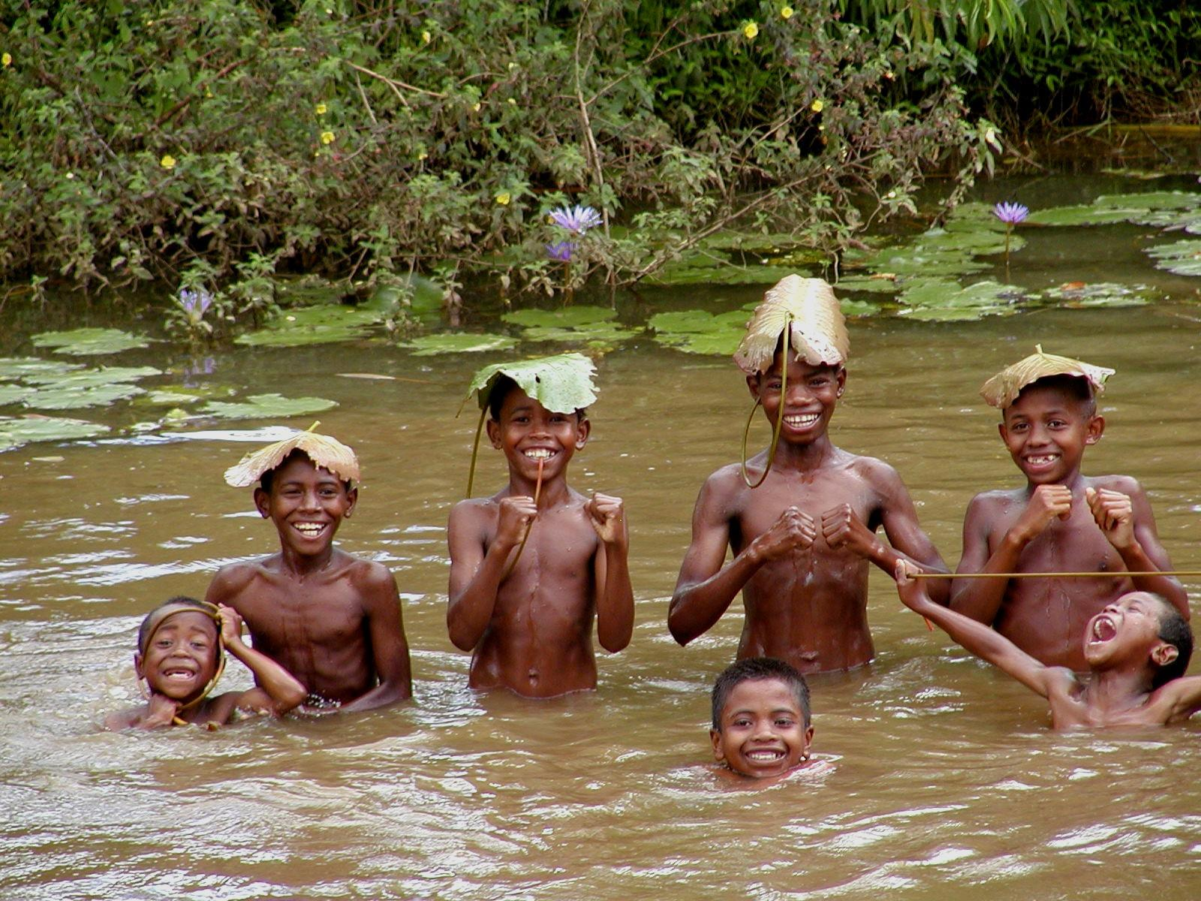
Thank you for your good work

